Slide 1
HTML & CSS

Slide 2
Remember to check-in on BCS

Slide 3

Where to get Help
Practice, Practice, Practice: Work Individually or in Groups
Review In Class Material (Exercises):
Linked in GitLab
Review Code Drills:
Linked in GitLab
In Class Office Hours: 45 minutes before class , 30 minutes after
Contact Student Success: Anytime!

Slide 4

Student Instructional Staff Support
TA Office Hours (9:15-10am, 2:30-3pm) M-F
Review Breakout Room - for reviewing recent class content ( Manuel )
Homework Breakout Room - for students to work on Homework
Tutoring
Starting in Week Two
Procedure listed on Gitlab
Learning Assistant
Online 1:1 support - Expect to receive support from Learning Assistants in under 30 minutes (during active Hours)
See Gitlab for instructions
Organized Repository of all Activities and Concepts: Gitlab
Activities to review
Video Walkthroughs

Slide 5

Reminder - You have Homework!
Everyone should have access to the homework repository on GitLab that includes all instructions and additional guidelines
The first homework is due Thursday at 11:59PM

Slide 6
Today’s Objectives
You will make more HTML documents!
You will learn to properly use basic HTML tags.
To gain initial exposure to HTML/CSS and how the two are linked using element selectors
To become comfortable working with HTML relative paths
You will implement basic CSS styling to HTML documents.

Slide 7
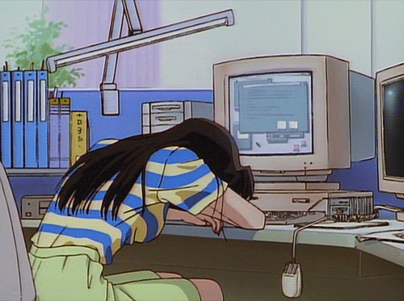
Know Thyself
If you are a complete beginner to HTML/CSS and Coding
Continue getting comfortable with HTML.
Be able to completely write a basic HTML document (like in last class).
Understand what CSS is, what it’s for, and how it works with HTML.
Be able to use Git and GitHub to upload code.
If you’ve had past exposure and felt comfortable with the last lesson
Aim to build up your skills. Clear up any questions or confusions about HTML.
Become knowledgeable about a wider range of HTML and CSS tags.
Be able to selectively apply CSS to specific HTML elements.
Be able to use Git and GitHub to upload code.

Slide 8

It’s Okay
Remember - you got this!

Slide 9
Let’s Git
Activity: myClass Repo | Suggested Time: 10 mins
Using GitHub and the Command Line:
Find your private GitHub repository named my-class-repo Be
Next, Unzip the directory slacked to you
Using your finder or explorer copy the new activities into your new directory
Add, Commit, and Push the code to GitHub.

Slide 10
<h1>This is mah house</h1>
HTML Syntax
content
Opening tag
closing tag

Slide 11
<a href=”google.com”>My Link</a>
Attributes
content
attribute
Opening tag
closing tag

Slide 12
Self Closing Tags
Self Closing Tags..
<br /> – single line break in a paragraph
<hr /> – change in type of content
<img /> – image <input /> – input field
<link /> – include an external style sheet
<meta /> – metadata about the page
ETC.
According to the new HTML 5 spec, you can choose to add or leave off the ending forward-slash.

Slide 13
Important Common Tags
Headings
<h1></h1> - Heading 1 (Largest Heading)
<h2></h2> - Heading 2 (Next Largest Heading)
<h3></h3> - Heading 3
Containers
<html></html> - Wraps the entire page
<head></head> - Wraps the header of the page
<body></body> - Wraps the main content
<div></div> - Logical Container ***
<p></p> - Wraps individual Paragraphs
Others
<strong> (bold), <em> (emphasis)
<img> (images), <a href> (links), <li> (list items) , <title> (title),
<br> (line break), <table> (tables), <!-- --> (comments)

Slide 14
<div> vs <section>
<div> tags
Used to group elements into visually related segments and that they are primarily used as "hooks" for CSS styling.
<section> tags
Used to group elements into thematically related segments.
<div> and <section> tags behave identically, in that both are block-level tags used to demarcate sections of a site.
The difference between <div> and <section> tags is dependent on what we want our source code to communicate to other developers, the browser or SEO Crawlers.

Slide 15
Less Common Tags
All HTML Tags are listed here: http://www.w3schools.com/tags/
Don’t try to memorize them! Simply refer back to documentation as needed.
Other tags...
<video> for Videos
<audio> for Audio files
<embed> for Embedded files
<code> for including computer code
<header> for headers
<nav> for navigation bars
<footer> for footers

Slide 16
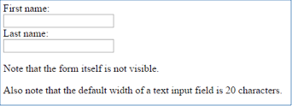
HTML for Forms
Common UI (User Interface) Form Elements:
<form> - Creates a form section in HTML
<input> - Input boxes
<label> - Labels for boxes
<button> - Button
<textarea> - Large textbox
<form>
First Name:<br>
<input type=”text” name=”firstname”><br>
Last Name:<br>
<input type=”text” name=”lastname”>
</form>

Slide 17
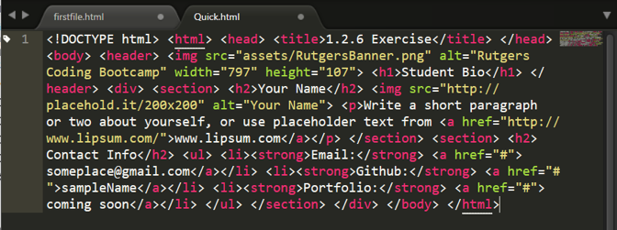
On ugly HTML...
Please don’t do this...
Use proper indentation and sectioning.
Readable code is easier to maintain.
Invest time to get better about this now. It will pay dividends!

Slide 18
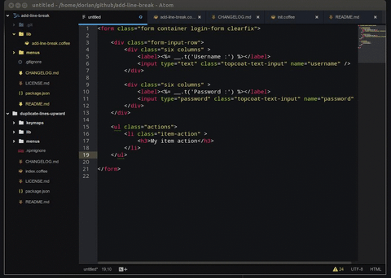
Explore The Code - Pair
Activity: 04-review-HTML_Tags Suggested Time: 10 mins

Slide 19
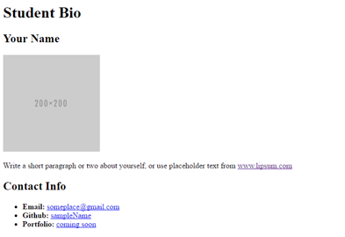
Your Turn!
Activity: 05-HTML | Suggested Time: 20 mins
Assignment:
Create a basic HTML page with your own information that looks similar to the design shown on screen.

Slide 20
Your Turn!
Activity: 06-Stu_FixThe_HTML | Suggested Time: 10 mins
Assignment
Open the file inside the `Unsolved` folder.
This HTML document has several errors. While it may seemingly load browser without many issues, this is not valid HTML.
Correct the document and leave a comment above each error describing what you changed.
Refer to the Mozilla HTML Documentation (https://developer.mozilla.org/en-US/docs/Web/HTML) to research any unfamiliar HTML tags.
Add, Commit, and Push the code to GitHub.

Slide 21
CSS Stylin’

Slide 22

HTML/CSS Definitions (yawn - boring!)
HTML: Hypertext Markup Language – (Content)
CSS: Cascading Style Sheets – (Appearance)
HTML/CSS are the “languages of the web.” Together they define both the content and the aesthetics of a webpage – handling everything from the layouts, colors, fonts and content placement. (JavaScript is the third – handling logic, animation, etc.)

Slide 23


An Analogy...
HTML alone…
Like writing in Notepad…
Can only write unformatted text
boring
HTML with CSS
Like writing papers in Microsoft Word
Can format text, page settings, alignment, etc. based on “highlighting” and menu options.
you can do this
Please don’t though

Slide 24
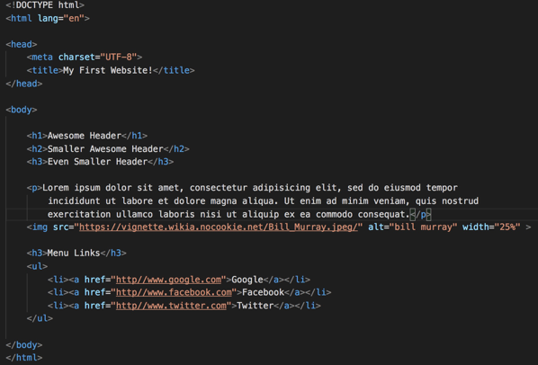
A basic HTML Page

Slide 25
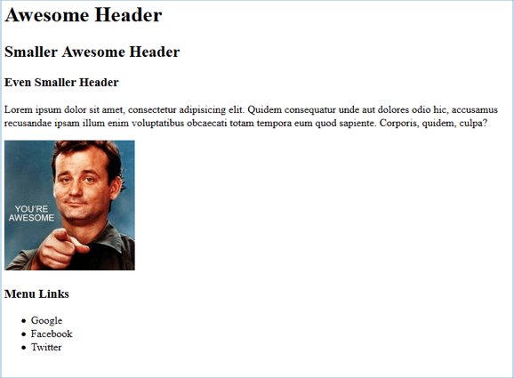
A basic HTML Page

Slide 26
That looked… boring

Slide 27
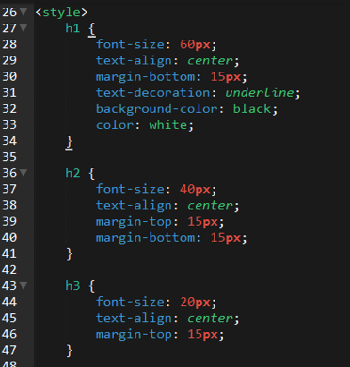
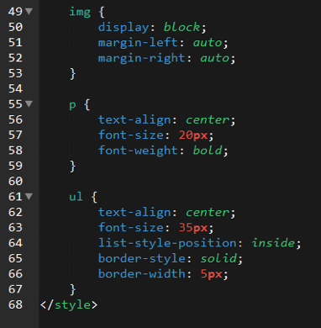
Enter CSS

Slide 28
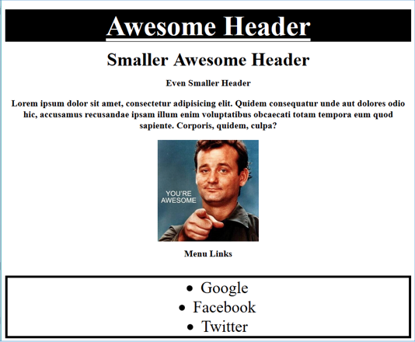
The Result

Slide 29

CSS Syntax
CSS works by hooking onto selectors added into HTML using classes and identifiers.
Once hooked, we apply styles to those HTML elements using CSS.

Slide 30
An Example...
In the below example the “Header” would be turned blue and MUCH larger because of the CSS.
We can incorporate an element’s class or ID to apply a CSS style to a particular part of the document.
Just remember to include the necessary symbol before the CSS: “.” for class, “#” for ID.
HTML <p class=“bigBlue”>Header</p> | CSS .bigBlue { font-size: 100px; color: blue; }

Slide 31
Key CSS Attributes
Font / Color
color: Sets color of text.
font-size: Sets size of the font.
font-style: Sets italics.
font-weight: Sets bold.
Alignment / Spacing
padding (top/right/bottom/left): Adds space between element and its own border.
margin (top/right/bottom/left): Adds space between element and surrounding elements.
float: Forces elements to the sides, centers, or tops.
Background
background-color: sets background color.
background-image: sets background image.

Slide 32

A Powerful Duo
Believe it or not, HTML / CSS is all you need
to develop a vivid, full-blown website.

Slide 33
Code Review
(quick-example-internal-css.html | 07-BasicCSS)

Slide 34
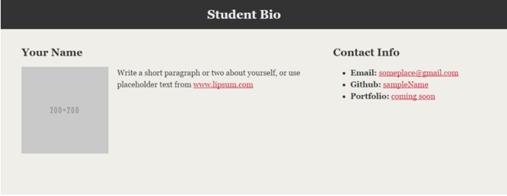
Your Turn!
Activity: 08-HTML_CSS_Layout | Suggested Time: 20 mins
Assignment
In this activity, you’ll upgrade your previous HTML bio-page using CSS style rules.
Additional instructions in Gitlab 06-HTML_CSS_Layout.
Add, Commit, and Push the code to GitHub when complete.

Slide 35
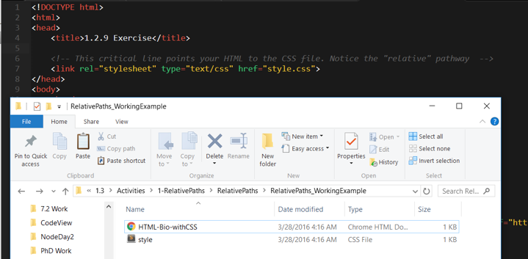
Relative File Paths
Relative file paths connect us with other files in our working directory. In this case, style.css is in the same folder as our html document.

Slide 36

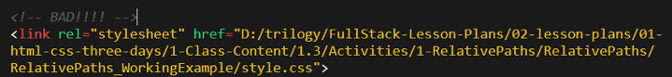
NO Absolute Paths!
ALWAYS USE RELATIVE FILE PATHS.
If you deploy your sites without them, all of your links will fail.
The same will happen if you move your project from one folder to another.
Remember, there is no such thing as a “C:” drive on the internet.

Slide 37
Code Review
(RelativePaths_DEMO | 09-RelativePaths-Activity/Demo)

Slide 38
Your Turn!
Activity: 09-RelativePaths-Activity | Suggested Time: 10 mins
Assignment
Examine the 09-RelativePaths-Activity/unsolved.
Edit the HTML files in all of the “RelativePaths” folders. You need to write relative paths that link the HTML documents with CSS stylesheets.
Tip: Check out the “0-RelativePaths-Activity/demo” folder.
Add, Commit, and Push the code to GitHub when complete.

Slide 39

It’s Lunch Time!
Return @ XX:XX

Slide 40
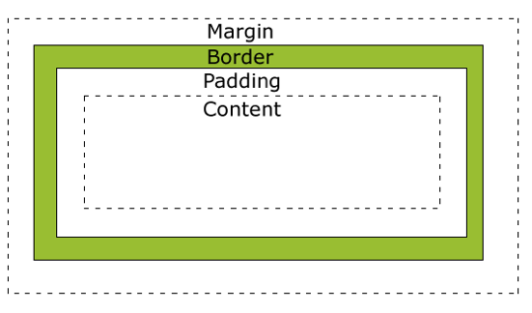
Box Model
In CSS, every element rests within a series of boxes.
Each box has customizable space properties:
margin, border, and padding.
Typical spacing value: 20px 10px 10px 20px (top, right, bottom, left)

Slide 41
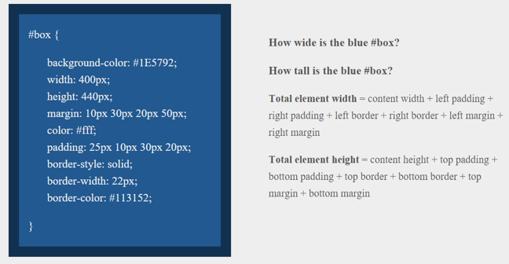

Slide 42
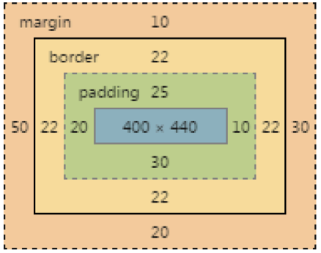
Answer
Width: 474 px (no margin), 554 px (with margin)
Height: 539 px (no margin), 569 px (with margin)

Slide 43
Width (No Margin)
Content width => 400px
Padding: 10px + 20px => 30px
Border Width: 22px + 22px => 44px
474px (no margin)
Margin: 30px + 50px => 80px
554 px (with margin)
Height (No Margin)
Content height => 440px
Padding: 25px + 30px => 55px
Border Width: 22px + 22px => 44px
539 px (no margin)
Margin 10px + 20px => 30px
569 px (with margin)

Slide 44
We all float down here

Slide 45

Take a break...
Warning!
These next topics are fairly tricky… but VERY IMPORTANT.
Time to channel your inner genius

Slide 46

The Concept of Flow
By default, every HTML element displayed in the browser is governed by a concept called flow.
This means that HTML elements force their adjacent elements to flow around them.

Slide 47
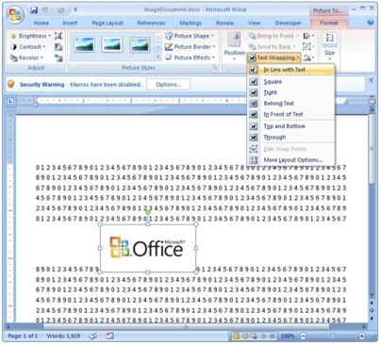
An Analogy...
This concept of “flow” is very similar to the wrap-text options you may be familiar with in Microsoft Word.
Just as in MS Word, you can have images in-line with text, on-top of text, etc.

Slide 48
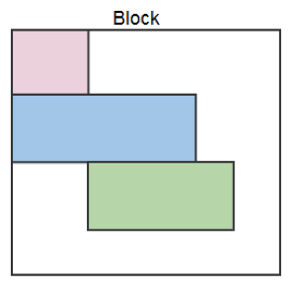
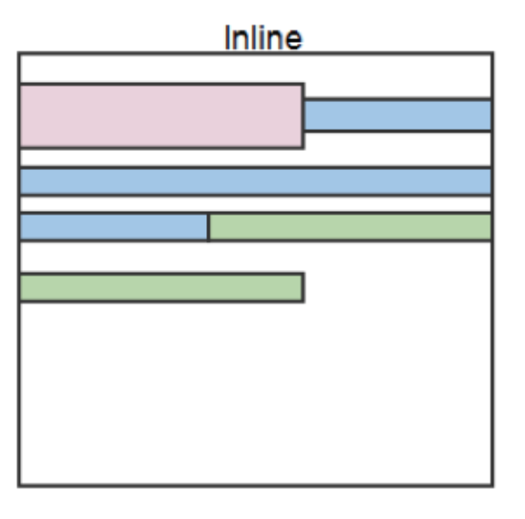
Block Elements
By default, web clients render many HTML elements as block elements. Paragraphs, headers, divs and more receive this treatment.
A block element will take up an entire line of space—unless you intervene with CSS properties.
Block: p. H1 -h6. ol, ul, div…
Inline: span, code, button, etc…

Slide 49
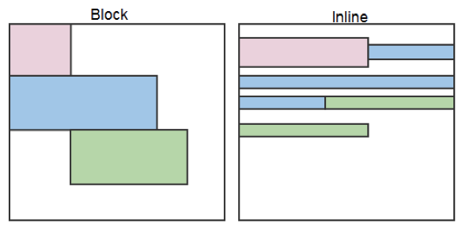
Block vs Inline Elements
Now contrast the block elements with inline elements.
By using float CSS properties, we can command our website to display multiple HTML elements adjacently.

Slide 50
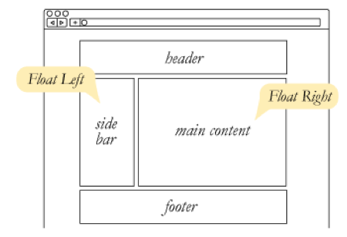
Floating
To transform these block elements into inline elements, we use a CSS property called float.
Floats are necessary for building web layouts.

Slide 51
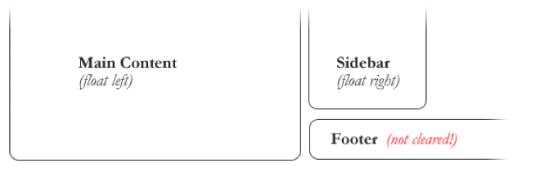
Clearing Floats
Floats often get in the way of our layouts.
Sometimes we don’t want to give each element the “inline” treatment.

Slide 52
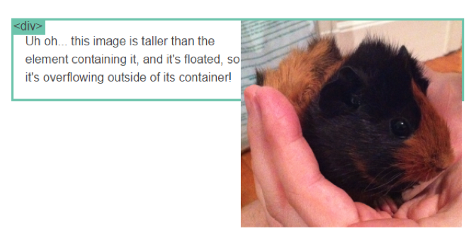
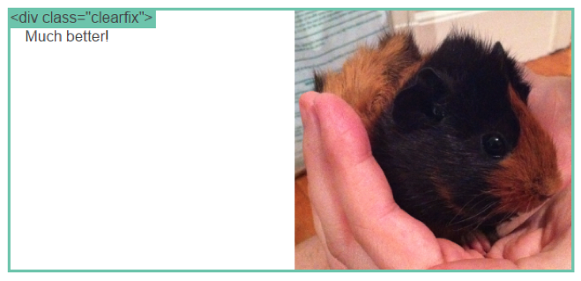
Clearfix Hack
Sometimes when elements don’t match up in size, we get situations like the image to the left…
We can get around this by using “the clearfix hack.”

Slide 53
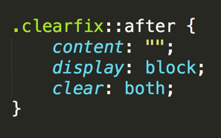
Clearfix Hack
::after is what we call a pseudo-element. We use it to style specific parts of an element.
This will add an HTML element, hidden from view, after the content of the “.clearfix” element. This clears the float.

Slide 54


Slide 55
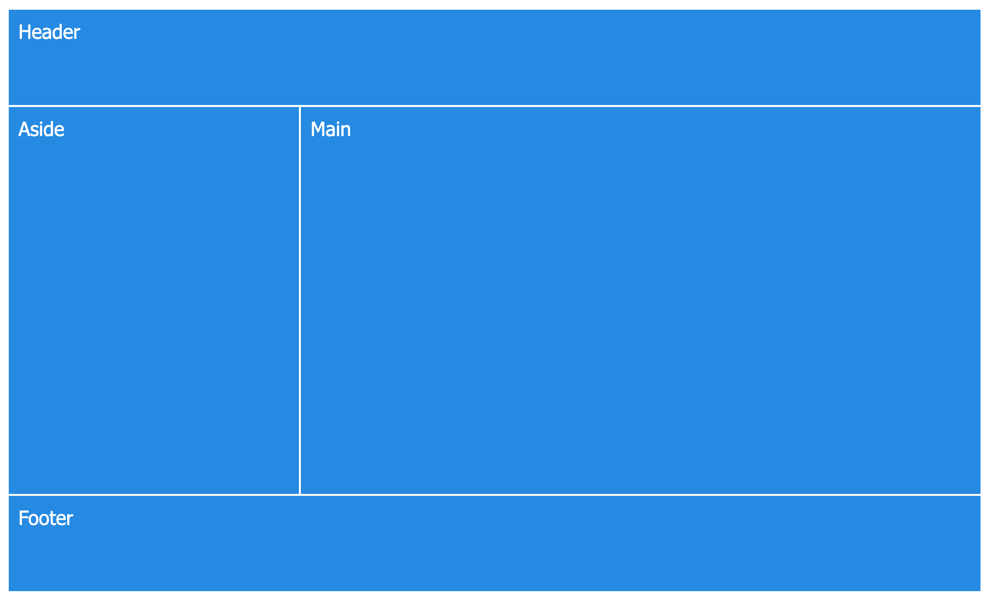
Code Exploration: Float Code 10-FloatExamples

Slide 56
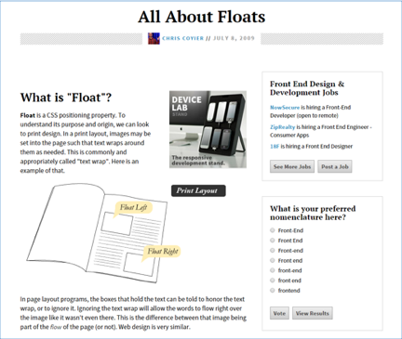
Additional Reading
Check Student Resources!
One crucial read - https://css-tricks.com/all-about-floats/

Slide 57
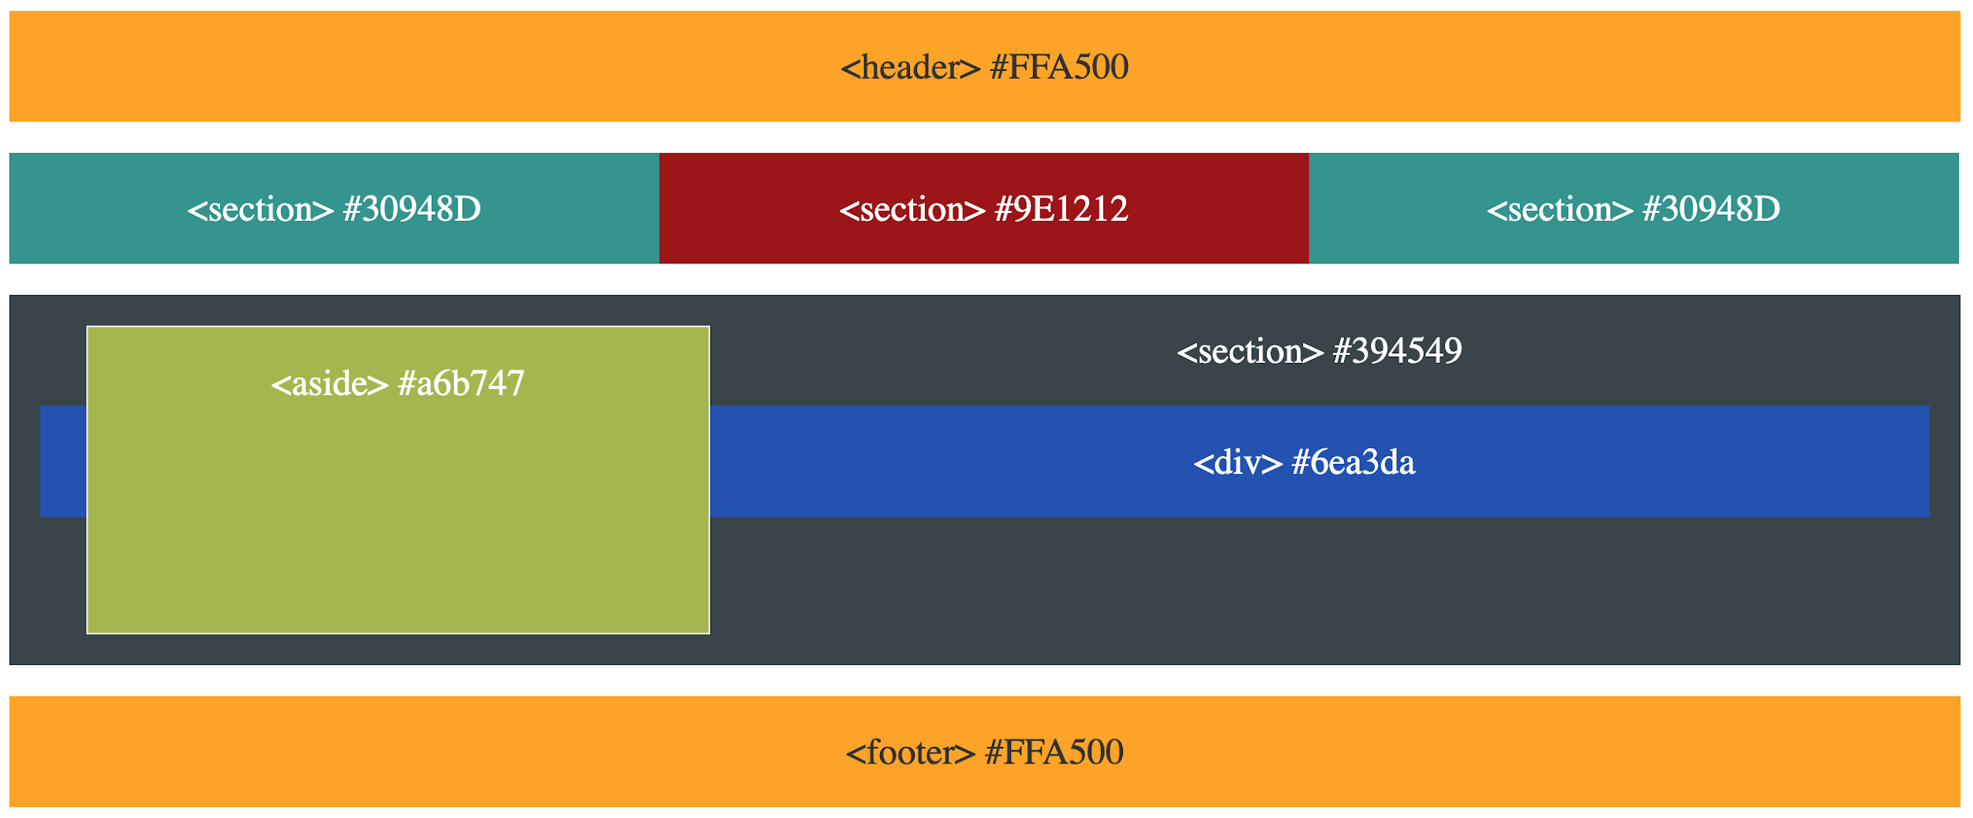
Your Turn!
Activity: 11-FloatLayout-Activity | Suggested Time: 45 mins
Assignment
In this activity, you’ll flex your newfound floating skills by creating a conceptual layout. Eyeball the design to your best ability.
Check Gitlab for more instructions…. Work in Pairs
Add, Commit, and Push the code to GitHub when complete.

Slide 58

Your Turn!
Activity: 11-FloatLayout-Activity | Suggested Time: 45 mins

Slide 59

Great job today!

Slide 60


Homework Time!

